Slide 1
How to ACE an interview?
Mingjia, Joy

Slide 2
Warm Up Discussions

Slide 3
Finding Opportunities
Personal Connection
E.g. advisor, classmate, graduated students
Websites
Google, Linkedln, Handshake, or the companies’ official websites
Job Searching Events

Slide 4
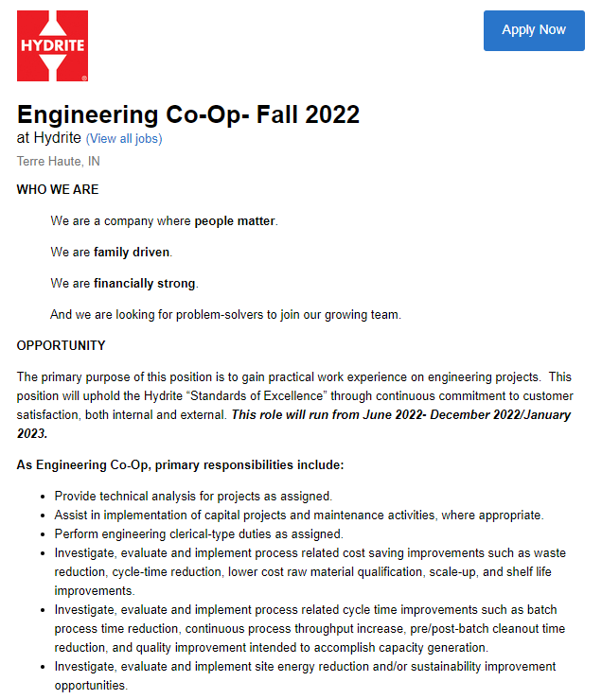
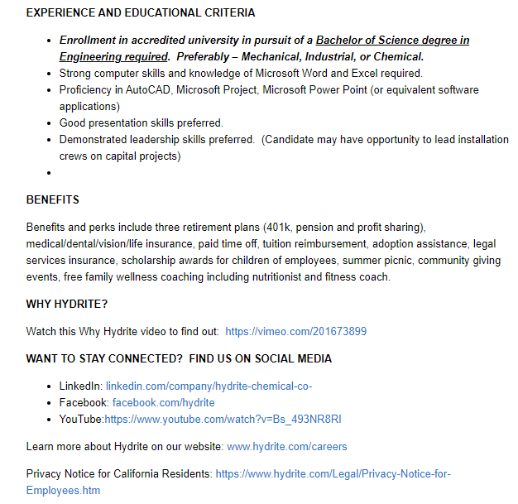
Read Job Descriptions

Slide 5
Read Job Descriptions
Select the most suitable one (or two)
Highlight skills, knowledge, and professional and personal qualities that are required by the employer
Gather other useful information (benefits, social media)
Modify both content and format of resume
Write a cover letter

Slide 6
Prepare for Interview Questions
Review resume and prepare to address gaps in your background
Do the research
Prepare answers for common questions
Recruit someone to practice
Prepare smart questions to the interviewer

Slide 7
During the interview
Manners
Dress properly
Keep calm
Don’t be late
Answering Questions
Know what you may and may not say
Guess what they look for and respond accordingly
Google: Be a good person and do the right thing. Be sure to show you are positive and you have an open-mind.

Slide 8
After the interview
Wait and don’t panic.
Keep looking and keep interviewing other companies.
Follow up (but don’t be annoying)
Personal Example

Slide 9
References
Engineering Co-op- fall 2022. Job Application for Engineering Co-Op- Fall 2022 at Hydrite. (n.d.). Retrieved October 27, 2021, from https://boards.greenhouse.io/hydritechemicalco/jobs/3441604.
Acosta, D. (2021, June 10). Job interview preparation tips to help you stand out. The Wall Street Journal. Retrieved October 27, 2021, from https://www.wsj.com/articles/how-to-prepare-for-a-job-interview-11605107862.

Slide 10
Group 1: Job Searching Strategy
Jenny and Danny are second-year phd students major in Chemical Engineering. Recently, they are trying to find internships for the summer.
Read through both people’s actions and summarize what they have done properly or what they should improve. During discussion, you can use your personal experience to help illustration.
Jenny met with her advisor, and also consulted other students who already had jobs. She made decisions based on these information. She managed to let one graduated student who already worked in P&G for recommendation.
Danny picked some companies that he heard from classmates, and went to their websites to find opportunities. Then he applied all the related positions. During the application, he used the same resume for all the positions.

Slide 11
Group 2: Read Job Descriptions
Jenny and Danny are second-year phd students major in Chemical Engineering. Recently, they are trying to find internships for the summer.
Read through both people’s actions and summarize what they have done properly or what they should improve. During discussion, you can use your personal experience to help illustration.
Jenny selected a job posting from the company and carefully read the job description. She modified the resume to highlight her qualifications that match the job requirements. To get the employer’s interests, she wrote a cover letter to show her uniqueness and enthusiasm.
Danny scanned all job descriptions. He updated his resume by listing all his experiences and skills. He reduced the font size to let everything fit into one page. To get the employer’s interests, Danny used LaTeX to make his resume looks fancy.

Slide 12
Group 3: Prepare for Interview Questions
Jenny and Danny are second-year phd students major in Chemical Engineering. Recently, they are trying to find internships for the summer.
Read through both people’s actions and summarize what they have done properly or what they should improve. During discussion, you can use your personal experience to help illustration.
One week before the interview: Jenny went to the company’s website for insight into workplace culture, recent news, and future goals. She practiced answering questions and then did practice interviews with a student who had an internship last summer.
One day before the interview: Danny went to the company’s “About Us” page to get a concise understanding of the company. Then he called Jenny to do a mock interview to calm his nerves.

Slide 13
Group 4: During the interview
Jenny and Danny are second-year phd students major in Chemical Engineering. Recently, they are trying to find internships for the summer.
Read through both people’s actions and summarize what they have done properly or what they should improve. During discussion, you can use your personal experience to help illustration.
Jenny was 10 minutes earlier to the place, and dressed formally. During the interview, she was nervous, and she sometimes didn’t answer directly to the question. At the end of the interview, she asked when could she get results.
Danny wore a T-shirt and slippers, and was 5 minutes late. He was quite confident and was able to answer all questions. At the end of the interview, he asked about the salary of the position.

Slide 14
Group 5: After the Interview
Jenny and Danny are second-year phd students major in Chemical Engineering. Recently, they are trying to find internships for the summer.
Read through both people’s actions and summarize what they have done properly or what they should improve. During discussion, you can use your personal experience to help illustration.
Jenny thought she didn’t perform well, but she wasn’t discouraged. She gained confidence quickly and kept looking for job.
Danny was super-confident about himself. But he got anxious since he didn’t receive any responses for 2 weeks. He sent an email to HR to ask about results.

